Slide 1
Rising Infant Childcare Costs in the United States
An Exploratory View Using the National Database of Childcare Prices
Maxim Bilenkin
DSC 640 Data Presentation & Visualization
Winter 2025-2026

Slide 2
Why This Matters
Infant childcare is a major expense for families
Costs have increased over time
Rising costs can affect family decisions and workforce participation

Slide 3
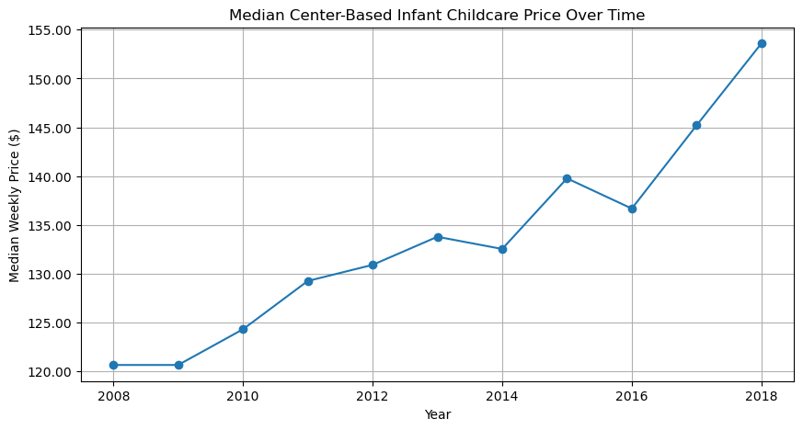
Childcare Costs Over Time
Median infant childcare costs increased steadily from 2008 to 2018
Overall costs rose by more than 25 percent during this period
While there were small year-to-year drops, the long-term trend is upward

Slide 4
Key Observations
Overall upward trend across the decade
Some years show small decreases
The long-term pattern is increasing costs

Slide 5
Implications for Families
Increased financial pressure on parents
Potential impact on birth rates
Greater burden on lower- and middle-income households

Slide 6
Policy Considerations
Expand childcare support programs
Increase childcare supply
Improve affordability and access

Slide 7
Closing Message
Childcare affordability is a growing concern
Data shows sustained increases over time
Policy attention is needed

Slide 8
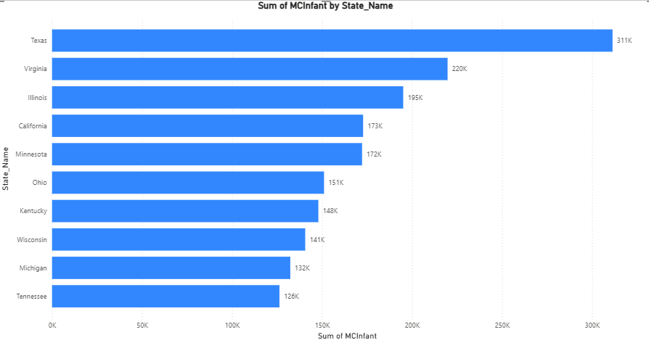
Dashboard – Infant Childcare Costs by State

Slide 9
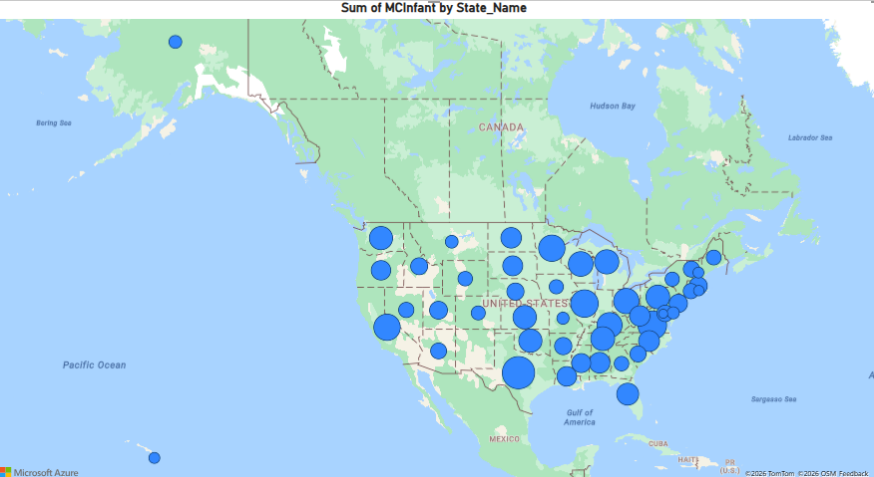
Dashboard – Geographic Distribution of Costs

Slide 10
Design Narrative
For this project, specific charts and dashboard visuals were chosen to clearly communicate the story of rising infant childcare costs. A line chart was selected to display childcare costs over time from 2008 to 2018. This chart shows a single line changing over time, which makes it easy for non-technical audiences to understand how prices have increased. Line charts are also commonly used in presentations, so for an audience such as policymakers and childcare lawmakers, this format is familiar and easy to interpret.
A geographic dashboard was used to display a map of the United States with circles that vary in size by childcare cost. Larger circles represent higher childcare costs, making it easy to see where families face greater financial pressure. This visualization allows policymakers and government agencies to quickly identify states where rising childcare costs may require more urgent policy attention or support programs.
A clustered bar chart was also included in the dashboard to show the top ten states with the highest infant childcare costs. While the geographic map provides a broad regional view, it can be difficult to determine exact rankings. The bar chart clearly displays states in order from highest to lowest cost, making comparisons more direct. For example, it becomes clear which states have the highest costs and which fall at the lower end of the top ten.
Simple color choices were used throughout the visuals to avoid distraction. Blue bars and lines on a white background were selected for readability and clarity. For the map, a green background with blue circles was used to keep the design clean and easy to follow. Overall, this design fits the policymaker audience because it allows viewers to quickly understand both long-term trends and regional differences without needing technical expertise. The combination of charts works together, with each visual highlighting information that the others cannot show on their own.

